Slide 1
CAR PRICE PREDICTOR
BY ROHIT RAMESH JAISWAL
IT VEDANT THANE

Slide 2
PROJECT NAME-CAR PRICE PREDICTOR
Description:
In this notebook, we are going to predict a car’s price using its’s model year,guel-type,number of owners,kms-Driven,etc.
The dataset we are going to use is the car price predictor dataset from Kaggle which contains about 892 rows and 6 features.
The dataset contains the labels which we have to predict and the labels are discrete and binary.

Slide 3
About Features :
Column id | Column Name | Description
1) | NAME | Name of car
2) | YEAR | Make year of Car
3) | COMPANY | Name of manufacturing company
4) | PRICE | Price of car
5) | KMS-DRIVEN | Kilometers driven by Owner
6) | FUEL-TYPE | Fuel type of car(Petrol,Lpg,Diesel,Cng)

Slide 4
Load libraries and dataset
import numpy as np
import pandas as pd
import matplotlib.pyplot as plt
import seaborn as sns
from sklearn.model_selection import train_test_split
from sklearn.linear_model import LogisticRegression
from sklearn.metrics import classification_report, accuracy_score
import warnings
warnings.filterwarnings("ignore")

Slide 5
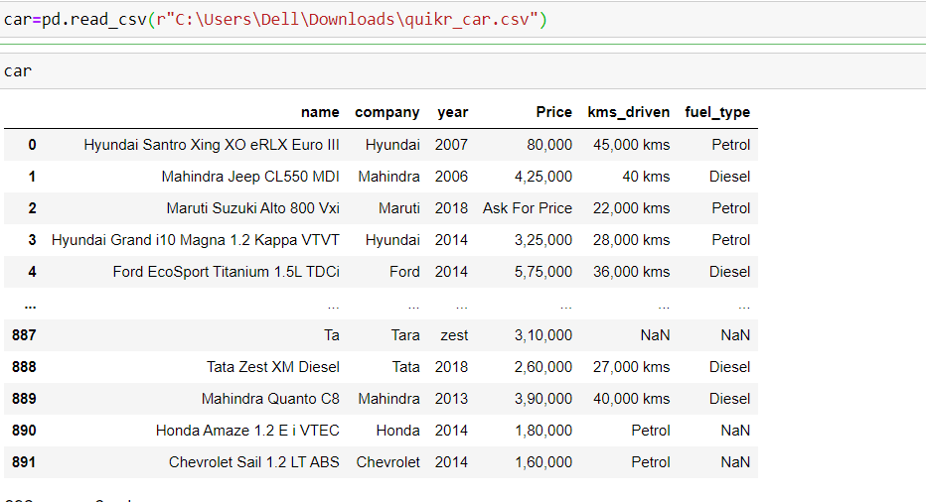
Step 1:Importing Dataset

Slide 6
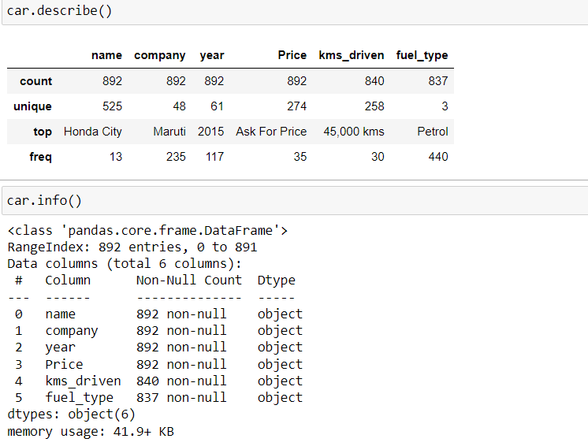

Slide 7
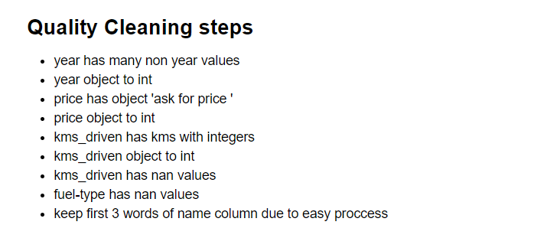
Step 2: Exploratory Data Analysis
Observations:
The dataset doesn't have any null values, but it contains some objects.

Slide 8
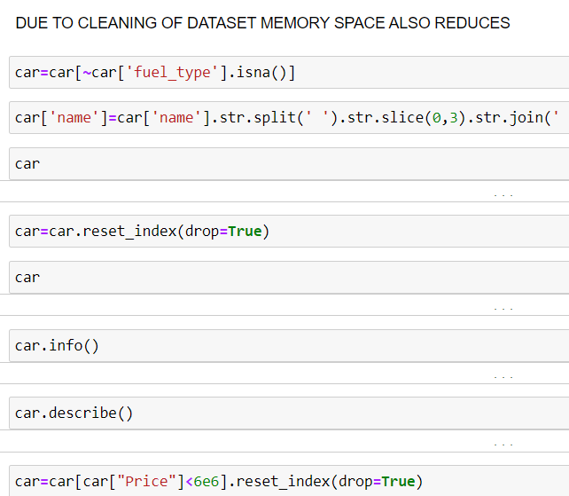
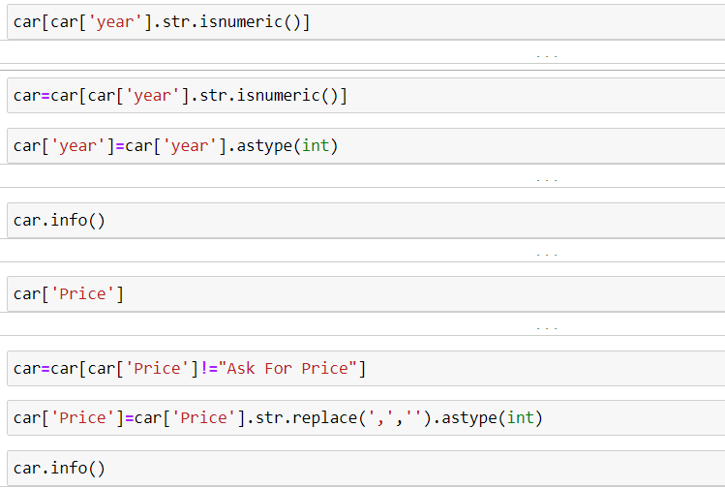

Slide 9
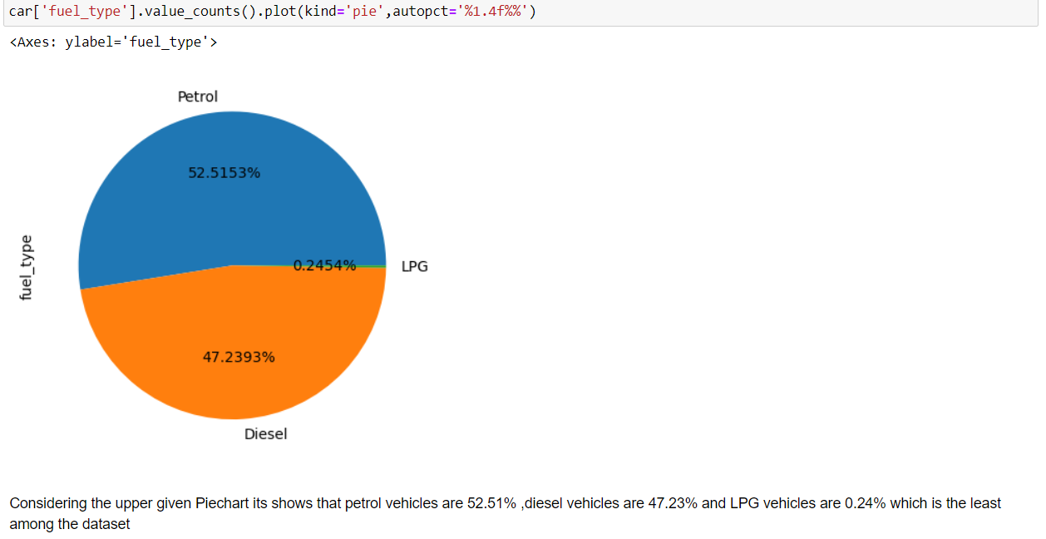
Step 3:Visualization

Slide 10
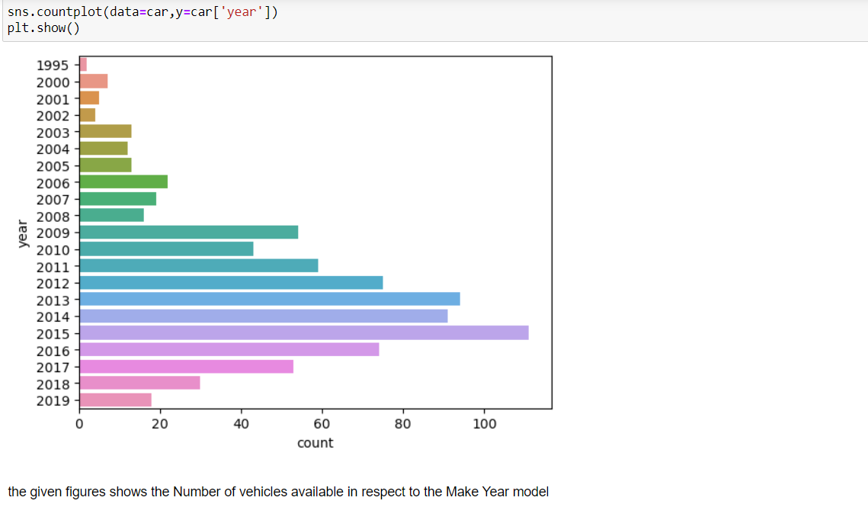

Slide 11
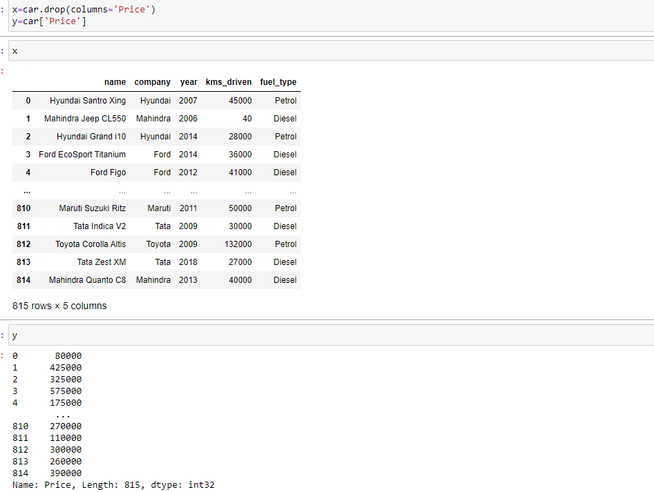
Step 4: Separting Data

Slide 12
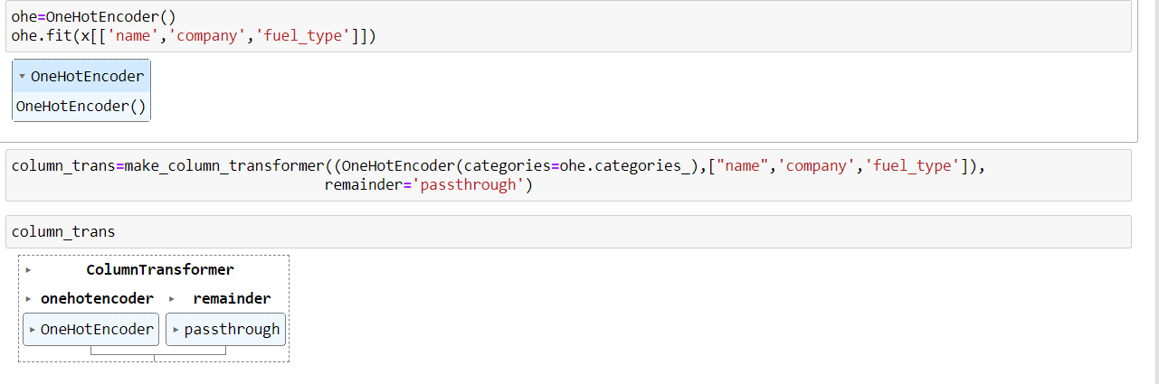
step 5: Using One hot Encoder and column transformer to transform column

Slide 13
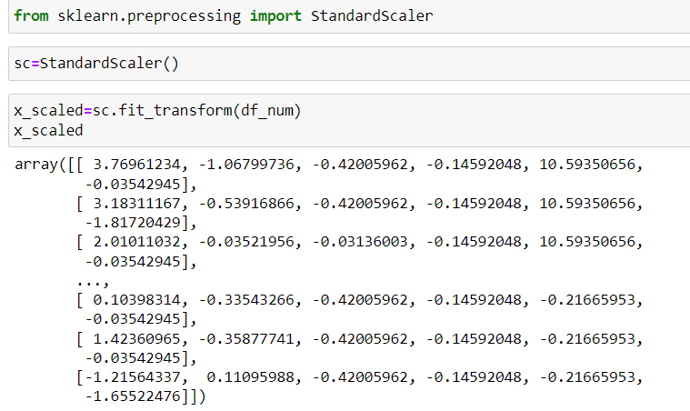
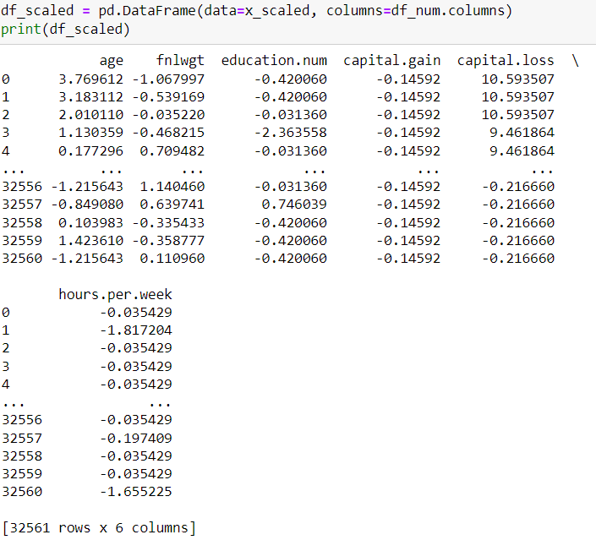
Step 6: Features Scaling

Slide 14
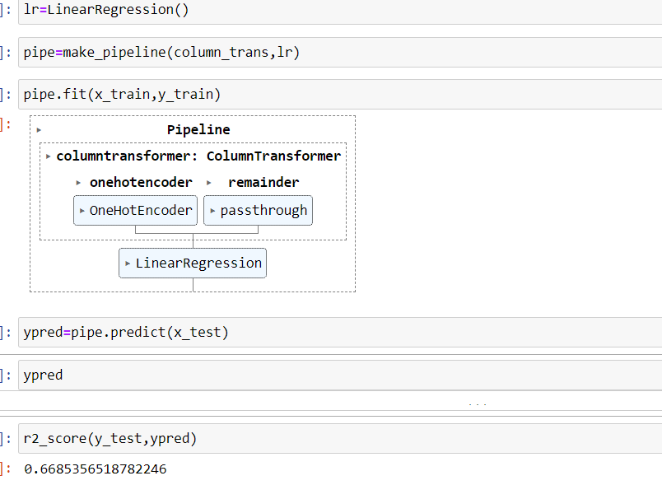
step 7: Using Linear Regression and r_2 score for Predicting score

Slide 15
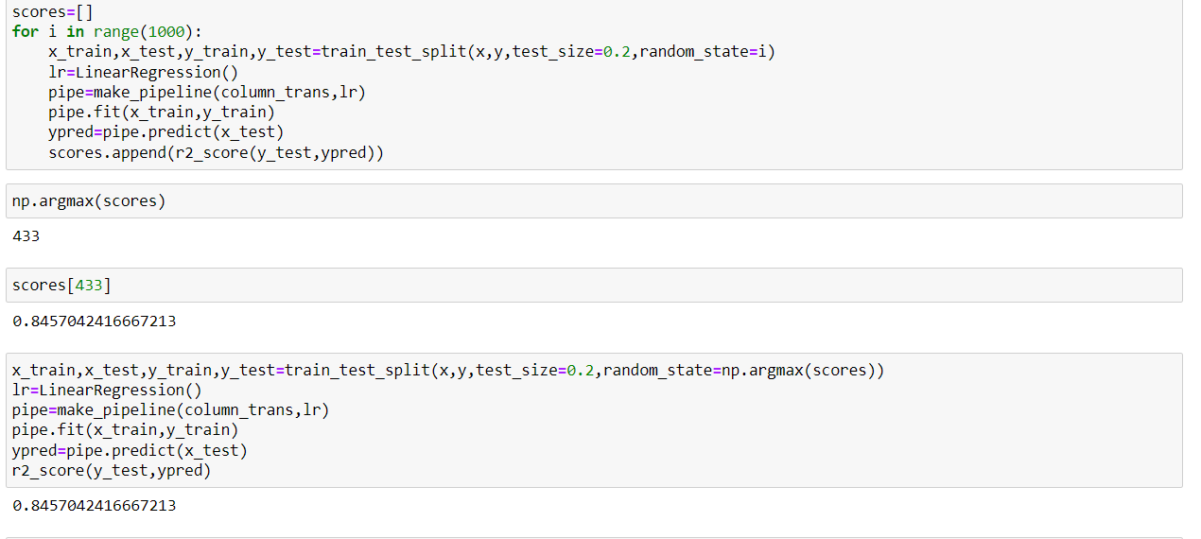
step 8: training and testing of data

Slide 16
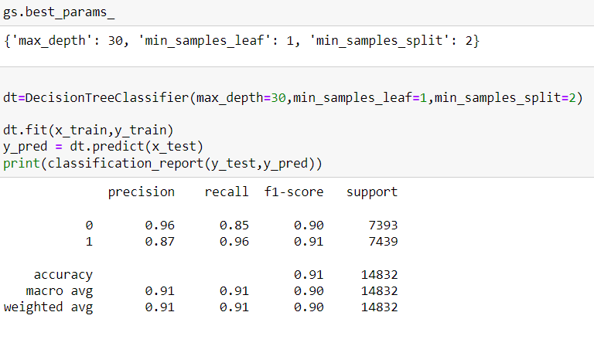
Conclusion:
In this project, we build various models like logistic regression, knn classifier,decision tree classifier,random forest classifier and Hyper Tuning Parameter Using GridSerachCV for logistic regression & decision tree classifier.
A Random Forest Classifier gives the highest accuracy score of 92.00 percent among all the ML Models.
Thus, for the Adult Census Income Prediction Dataset, the best accuracy can be achieved using Random Forest Model.
THANK YOU!

